Slide 1
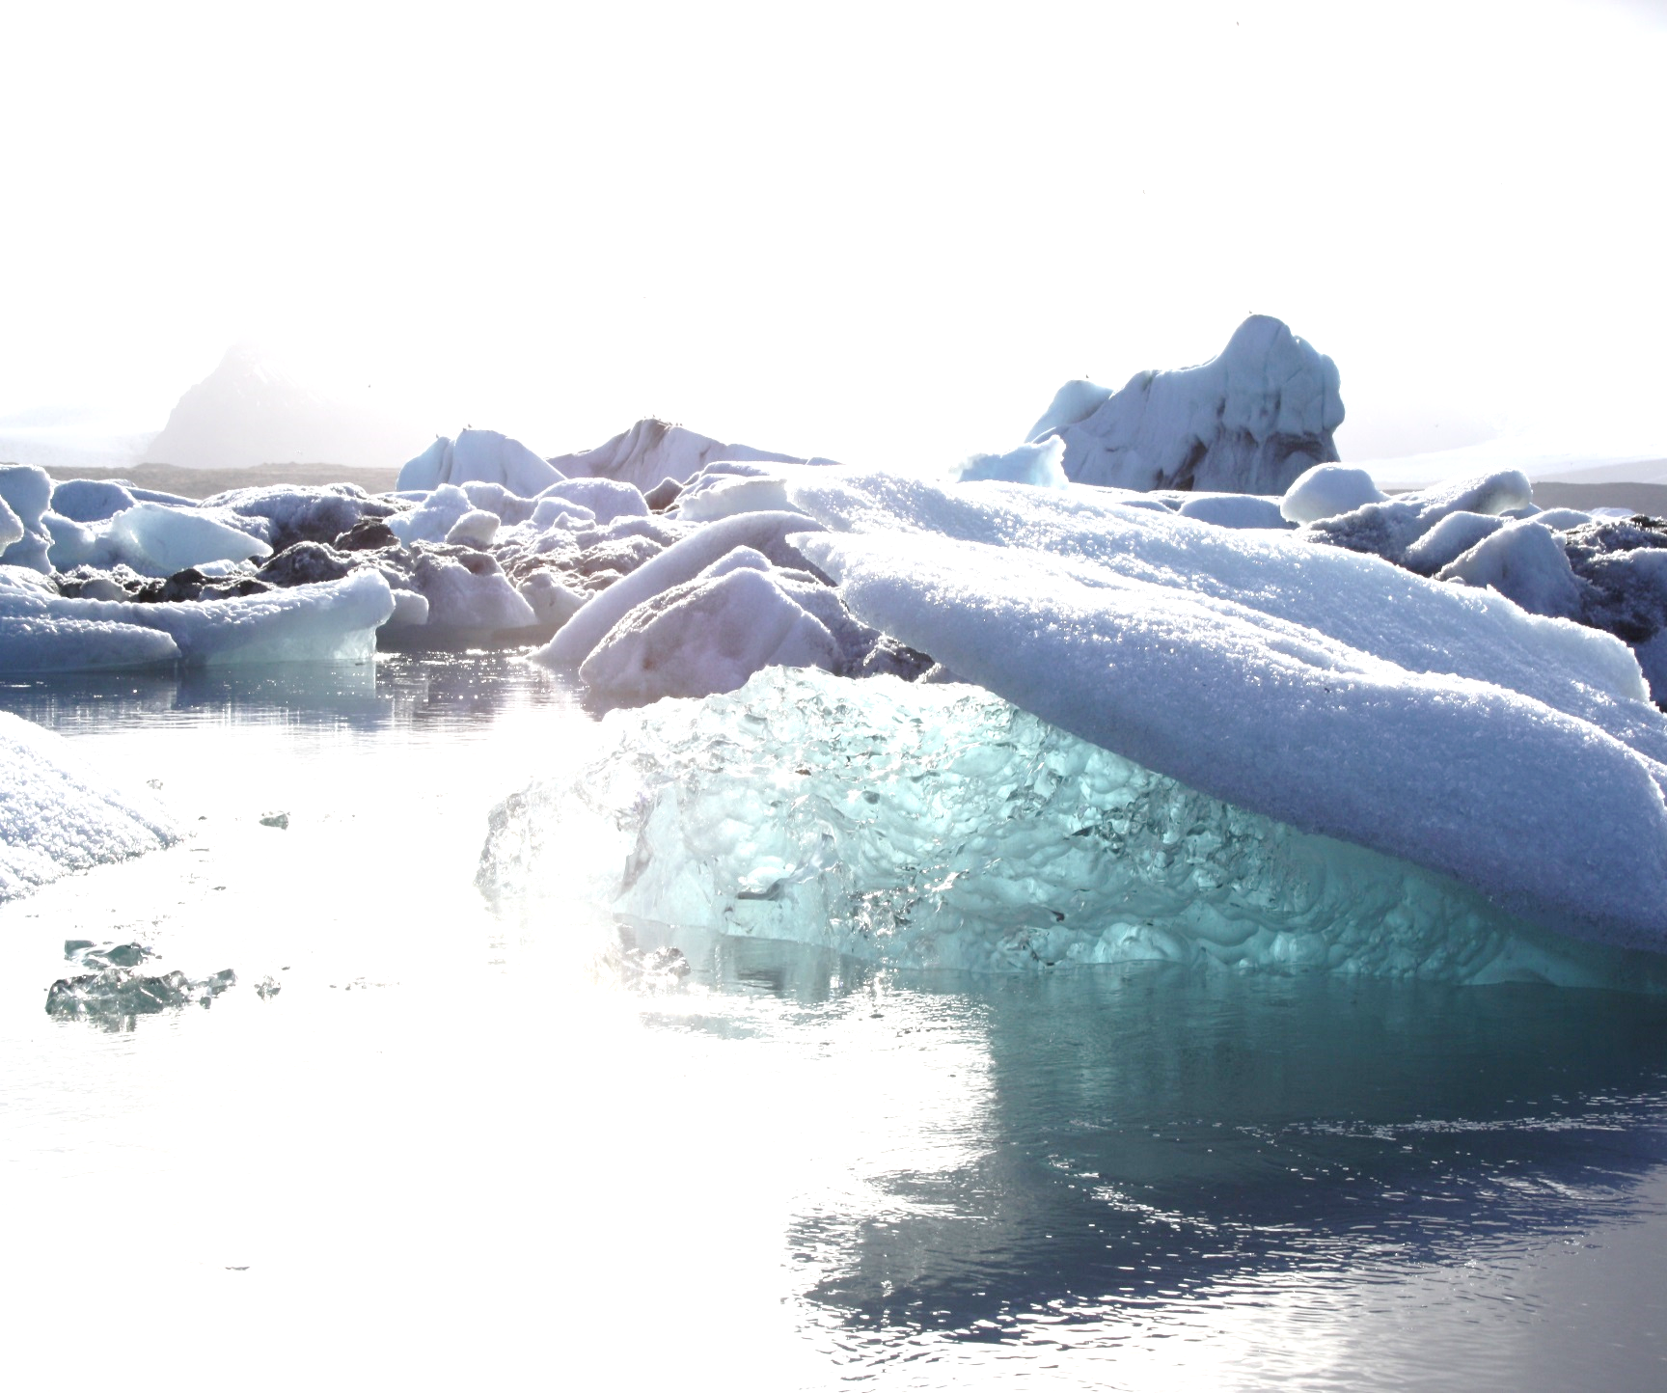
Natural Scientist

Slide 2
Defenders

Slide 3
Alternatives

Slide 4
Master student

Slide 5
Professor of Physics

Slide 6
3rd grader

Slide 7
Retailer of VW‘s

Slide 8
Coffee-to-go bar owner

Slide 9
Climate Scientist

Slide 10
Scientist

Slide 11
Environmental Activist

Slide 12
Scientist I

Slide 13
Scientist II

Slide 14
Social Scientist

Slide 15
Climate Skeptic

Slide 16
Journalist

Slide 17
Economist

Slide 18
Government Politician

Slide 19
Politician

Slide 20
Politician I

Slide 21
Politician II

Slide 22
  Business Representative

Slide 23
  Environmental NGO Representative

Slide 24
Mainstream Climate Scientist

Slide 25
Course Question

Slide 26
Media Critique

