Slide 1
Researching and Shaping
Climate Futures
J. Baehr, J. Behrens, L. Borchert, M. Brüggemann, L. Kutzbach, K. Linscott, A. Oberg
10th course day – June 18th, 2026
Moderator: Lars Kutzbach
Course coordination: Michael Brüggemann, Lars Kutzbach, Kat Linscott
Contact: Kat Linscott (katherine.linscott@studium.uni-hamburg.de)
1

Slide 2
Today’s Schedule
  Poster Session Preparation 30 min
  Roleplay # 2 40 min
  Reflection on Role-Play 15 min
  Homework # 5 5 min
2

Slide 3
  Poster Session Preparation
3

Slide 4
Progress Update
Room is booked! Conference room in the MIN-Forum Library (room 01-116) on 9 July 2026 from 9:00-16:00.
Subteam updates – current progress & next steps?
1: Scientific Committee: Screening and clustering of abstracts, thinking about moderation time, and milestone planning | Alyx, Marlene, Ibolya, Rami
2: Technical Team: Booking of rooms, organizing poster walls | Divanshu, Lucy, Mareike, Prashamsa
3: Advertising Team: Invitation emails, poster and/or flyer, social media? | Asli, Alicja, Tara
4: On-site Logistics Team: Prepare room, poster walls, tables registration desk, tables, ordering of food/drinks? | Carmen, Toni, Eva, Alina, Sarah
4

Slide 5
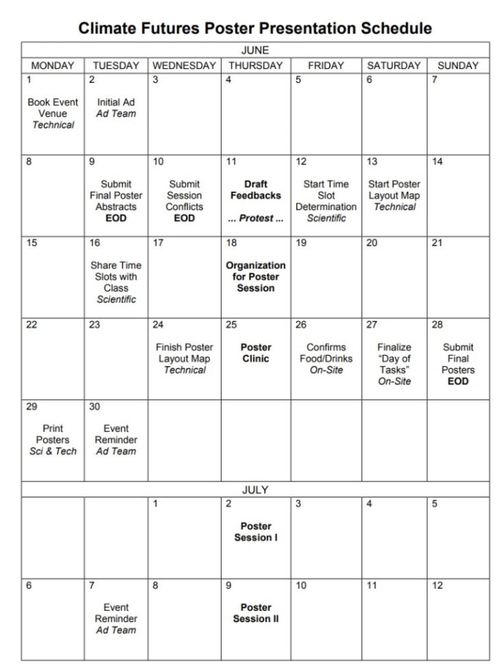
Work Period: Organisation of Poster Session Event
Next steps? Coordination with the other subteams?
Questions? Setbacks?
1: Scientific Committee: Screening and clustering of abstracts, thinking about moderation time, and milestone planning | Alyx, Marlene, Ibolya, Rami
2: Technical Team: Booking of rooms, organizing poster walls | Divanshu, Lucy, Mareike, Prashamsa
3: Advertising Team: Invitation emails, poster and/or flyer, social media? | Asli, Alicja, Tara
4: On-site Logistics Team: Prepare room, poster walls, tables registration desk, tables, ordering of food/drinks? | Carmen, Toni, Eva, Alina, Sarah

Slide 6
  Role Play #2
6

Slide 7
  Role-Play on Scientist Emissions
  Students
7

Slide 8
  Role-Play #2
Imagine that a disparaging article has just been published in a populist/right-wing newspaper (e.g., Die Bild) that accuses climate scientists of hypocrisy…
8

Slide 9
  Role-Play #2
“Climate scientists constantly preach that we must urgently reduce emission. They make you feel guilty about your vacation because the ludicrous price of trains forced you to fly. They tell our governments to levy a carbon tax on combustion engines that punishes the very farmers that feed our country.
And yet, these very scientists fly far more often and far further than the average citizen, to attend conferences in luxurious locations, where all they do is talk.
… Somehow, they are exempt from what they preach -- as if merely talking about the problem absolves them of their role in it, or as if what they do is simply too complicated to handle over video call…. If they cannot figure out a Zoom meeting, what makes them think that they can solve the climate crisis?
And if climate change is as big a concern as they claim, it’s time that climate scientists get off their high horse and lead by example.”
9

Slide 10
  Role-Play #2
…. In response to this, a prominent European climate researcher proposes that for THE global climate conference (fictional) held every year in Vienna, researchers should be held to account for their work-related transportation emissions.
They propose adopting the idea of personal CO₂ budgets: researchers will be required to track their individual work-related transportation emissions, with maximum annual budgets, which, once exceeded, result in a ban on in-person attendance for that year (participants can, of course, still participate over Zoom).
They also suggest potentially applying an emissions trading scheme.
10

Slide 11
  Role-Play #2
… This year’s conference coincidentally has a special panel on global transportation emissions & will mark the beginning of a special working group on the topic, that will develop guidelines for reaching net-zero in the transportation sector globally.
11

Slide 12
  Role-Play #2
The conference organizing committee sits down to discuss adopting this proposal.
Committee Members | Group
Member 1: a well-established researcher from somewhere in central Europe who has avoided flying for over 10 years and firmly believes strong action is required. This researcher works in climate modelling and uses a lot of supercomputer resources. | Lucy, Alina, Ibolya
Member 2: a researcher from Eastern Europe who finds travel difficult due to a disability and prefers to attend by zoom. They also have colleagues who anyways find it difficult to travel sustainably compared to those from Central Europe. | Alyx, Sarah, Carmen, Rami
Member 3: a junior researcher from North America who does remote fieldwork, who feels that this penalizes them, and should then not just include transportation emissions, but also, emissions from other research activities (e.g., model runs). | Toni, Eva, Alicja
Member 4: a researcher from Brazil (which has significant reserves of the rare earth minerals necessary for the renewable transition) that already lacks the funds to fly to conferences and has not managed to secure additional funding through a scholarship. | Mareike, Asli, Prashamsa
Chair of the Committee (Moderator) | Tara, Divanshu, Marlene
Group 1: Lucy, Alina, Ibolya
Group 2: Tara, Divanshu, Marlene
Group 3: Alyx, Sarah, Carmen, Rami
Group 4: Mareike, Asli, Prashamsa
Group 5: Toni, Eva, Alicja

Slide 13
  Reflection on Role-Play
13

Slide 14
  Homework # 10
14

Slide 15
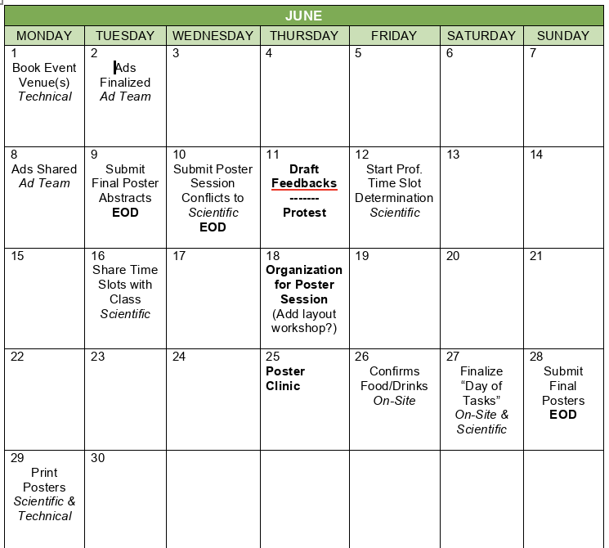
  Homework # 10
Poster session organization schedule
Homework #10a: Continue with poster session organization. Reminder of schedule on the right.
Homework #10b: Further develop your poster design for the peer feedback session next week (i.e., come with a near-final version).
TODAY
15

Slide 16
Poster: Updated Timeline
Task | until
Class: Introduction to poster tasks and grading (Lars) | 23.04.26
Homework: Post first ideas for a poster on the blog (100-200 words) | 30.04.26
Class: Input on poster design (Kat); Starting organisation of self-organized poster session (Kat) | 30.04.26
Homework: Comment on the blog on one poster idea (50-100 words) | 14.05.26
Homework: Post proposal for your poster topic including references (300-400 words) | 21.05.26
Class: Peer-peer feedback session; Poster session organization (Lars and Kat) | 21.05.26
Q&A poster task | 28.05.26
Homework: prepare first version of poster (digital and A4 printout) | 11.06.26
Class: Poster drafts feedback - speed dating | 11.06.26
Time for students to prepare poster session | 18.06.26
Poster clinic: peer feedback; Time for students to prepare poster session | 25.06.26
Poster Session practice session and event | 02.07.26, 09.07.26
CLICCS Retreat: Presentation of awarded posters | 30.09.-02.10.26

Slide 17
  Updated preliminary session plan
09.04. | Introduction to the course (L. Kutzbach); Introduction to the course blog (J. Behrens); Introduction to Climate Futures (L. Kutzbach)
16.04. | Mapping natural and societal dynamics constituting climate futures (A. Oberg);
23.04. | Introduction to poster task and grading criteria; poster session task (L. Kutzbach); Input on Epistemic Pluralism in Climate Science (K. Linscott et al.); Input on Transformative Science (M. Brüggemann)
30.04. | Mathematical perspectives on climate futures (J. Behrens); Introduction to poster design and starting organisation of poster session task (K. Linscott)
07.05. | Can we predict climate? (Johanna Baehr); 1st role-play on epistemic plurality and transformative science in CLICSS (students)
21.05. | Peer-peer feedback session; Poster session organization (K. Linscott and L. Kutzbach)
28.05. | Communicating climate futures (Michael Brüggemann); Q&A poster task
04.06. | Narrative-based near-term prediction of climate futures (Leo Borchert); discussion on desired futures
11.06. | Poster drafts feedback - speed dating
18.06. | Organisation of poster session; 2nd role-play (students)
25.06. | Poster clinic: peer feedback; preparation of poster session
02.07. | Poster presentation practice session
09.07. | Poster Session event (10:00-15:00)
16.07. | Feedback and Conclusions (students and lecturers)
17

